Slide 1


DESIGN 1
Lesson 2: Guided Practice: Sizing F1 Images
Ms. Abboud • Grade 9 - Design 1 • Term 1, Week 6

Slide 2
Learning Objectives
WALT - We Are Learning To
WILF - What I'm Looking For
Control image size with the width attribute.
Add a second image to the About Us page.
Both images are a sensible size for the page.
Both images have accurate alt text and working paths.

Slide 3
Academic Vocabulary
File Path
The route the browser follows to find a file: folder name(s) plus the filename, like images/pit-stop.jpg.

Slide 4
Frayer Model: File Path
DEFINITION
CHARACTERISTICS
The route the browser follows to find a file, like images/alfa-romeo-1950.jpg: the folder name(s) plus the filename.
The route to a file; includes folder names and filename.
FILE PATH
EXAMPLES
NON-EXAMPLES
images/pit-stop.jpg
A URL to a totally different website.

Slide 5
National Identity Integration
UAE Landmarks and Tourism: Yas Marina Circuit on Yas Island hosts the Abu Dhabi Grand Prix and welcomes visitors from around the world. Good images on a website help people picture a place before they visit.

Slide 6
STARTER
Quick Recap
What two attributes does every <img> need?
What does each one do?
Hook • Engage & Ask
5 - 10 minutes

Slide 7
LESSON CORE
I Do: The width Attribute
width sets how wide the image is on the page, in pixels.
Set only the width: the height adjusts to keep the picture's shape.
Gradual Release of Responsibility
30 - 40 minutes
Example: a sized image on About Us
<img src="images/alfa-romeo-1950.jpg"
alt="A red 1950 Alfa Romeo 158 racing car" width="300">
1 / 3

Slide 8
LESSON CORE
We Do: Checkpoint by Checkpoint
Checkpoint 1: give the Home page image a sensible width.
Checkpoint 2: add alfa-romeo-1950.jpg to About Us, next to the 1950 fact.
Broken image? Check the folder name and the file name first.
Gradual Release of Responsibility
30 - 40 minutes
2 / 3

Slide 9
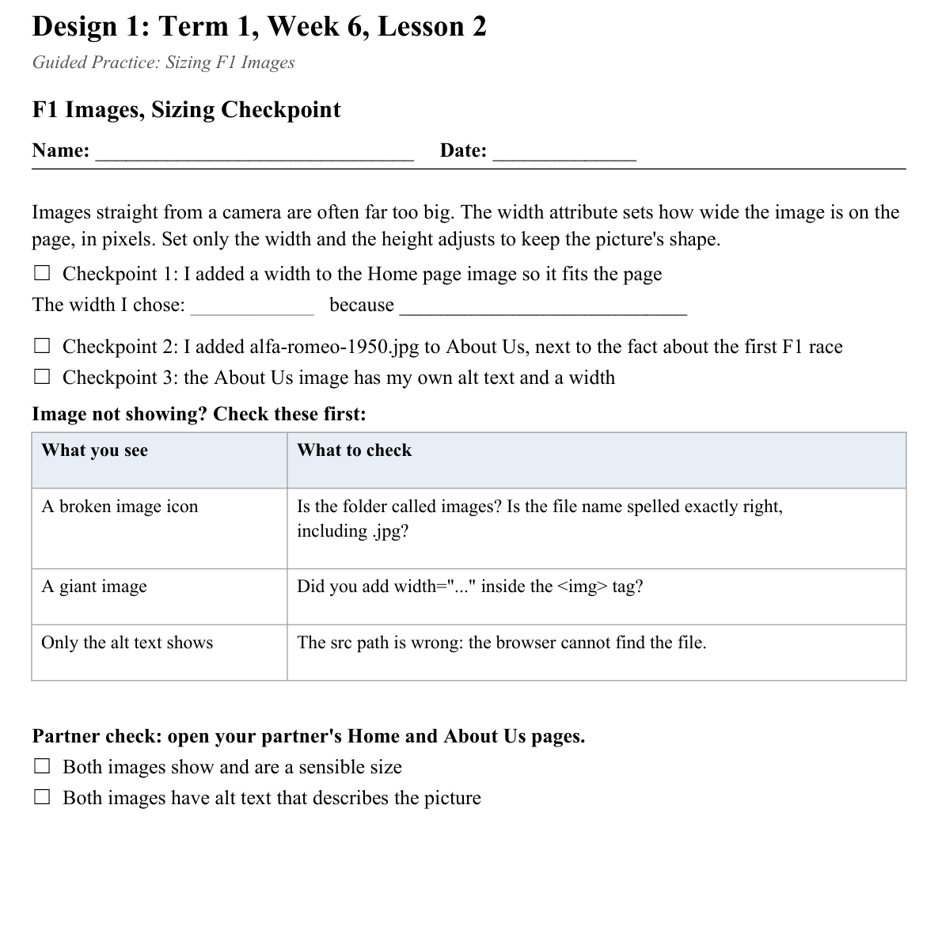
LESSON CORE
You Do: Size and Check
Finish both checkpoints, then swap screens for the partner check.
Activity: F1 Images, Sizing Checkpoint
Gradual Release of Responsibility
30 - 40 minutes
3 / 3

Slide 10
CLOSURE
Partner Check
Show a partner your About Us page: does it look planned, not broken or oversized?
Transition & Extend
5 - 10 minutes

